Slide 1
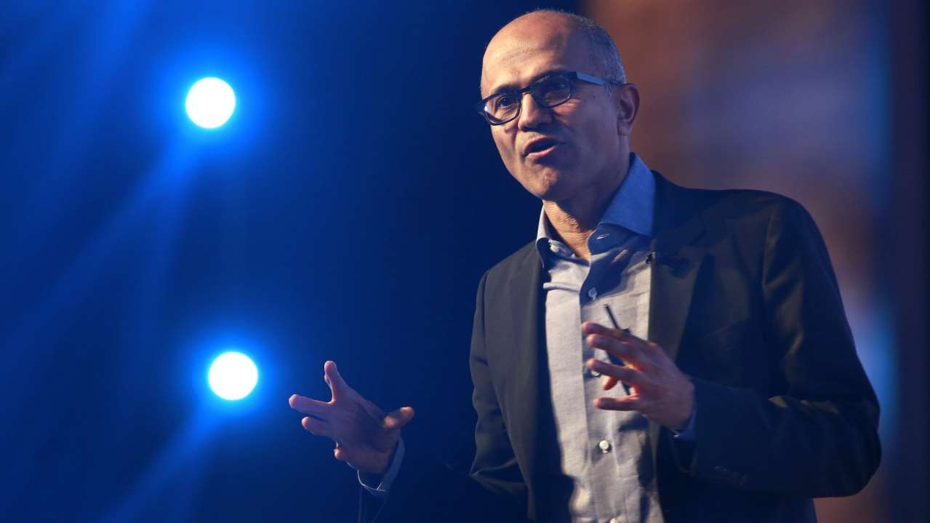

Digital Transformation using Microsoft 365
By Vignesh Ganesan
Technical Specialist– Microsoft 365
viganes@microsoft.com

Slide 2
Welcome

Slide 3

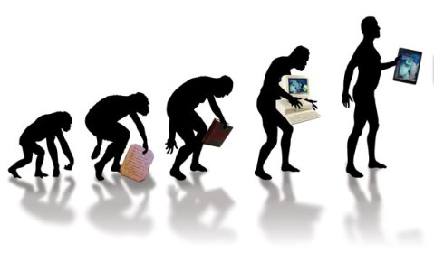

Slide 4
Digital transformation is the profound transformation of business and organizational activities, processes, competencies and models to fully leverage the changes and opportunities of a mix of digital technologies and their accelerating impact across society in a strategic and prioritized way, with present and future shifts in mind.
What is it ?
Digital transformation is the profound transformation of business and organizational activities, processes, competencies and models to fully leverage the changes and opportunities of a mix of digital technologies and their accelerating impact across society in a strategic and prioritized way, with present and future shifts in mind.

Slide 5
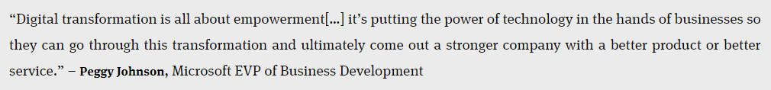
What is digital transformation? Digital transformation is about reimagining how you bring together people, data and processes to create value for your customers and maintain a competitive advantage in a digital-first world.
From Microsoft’s perspective:

Slide 6




Different type of Industrial Ages :

Slide 7
Disruption Everywhere

Slide 8


Slide 9

Wikipedia vs Library

Slide 10

amazon disrupting retail

Slide 11

I want to do this for my business to…

Slide 13
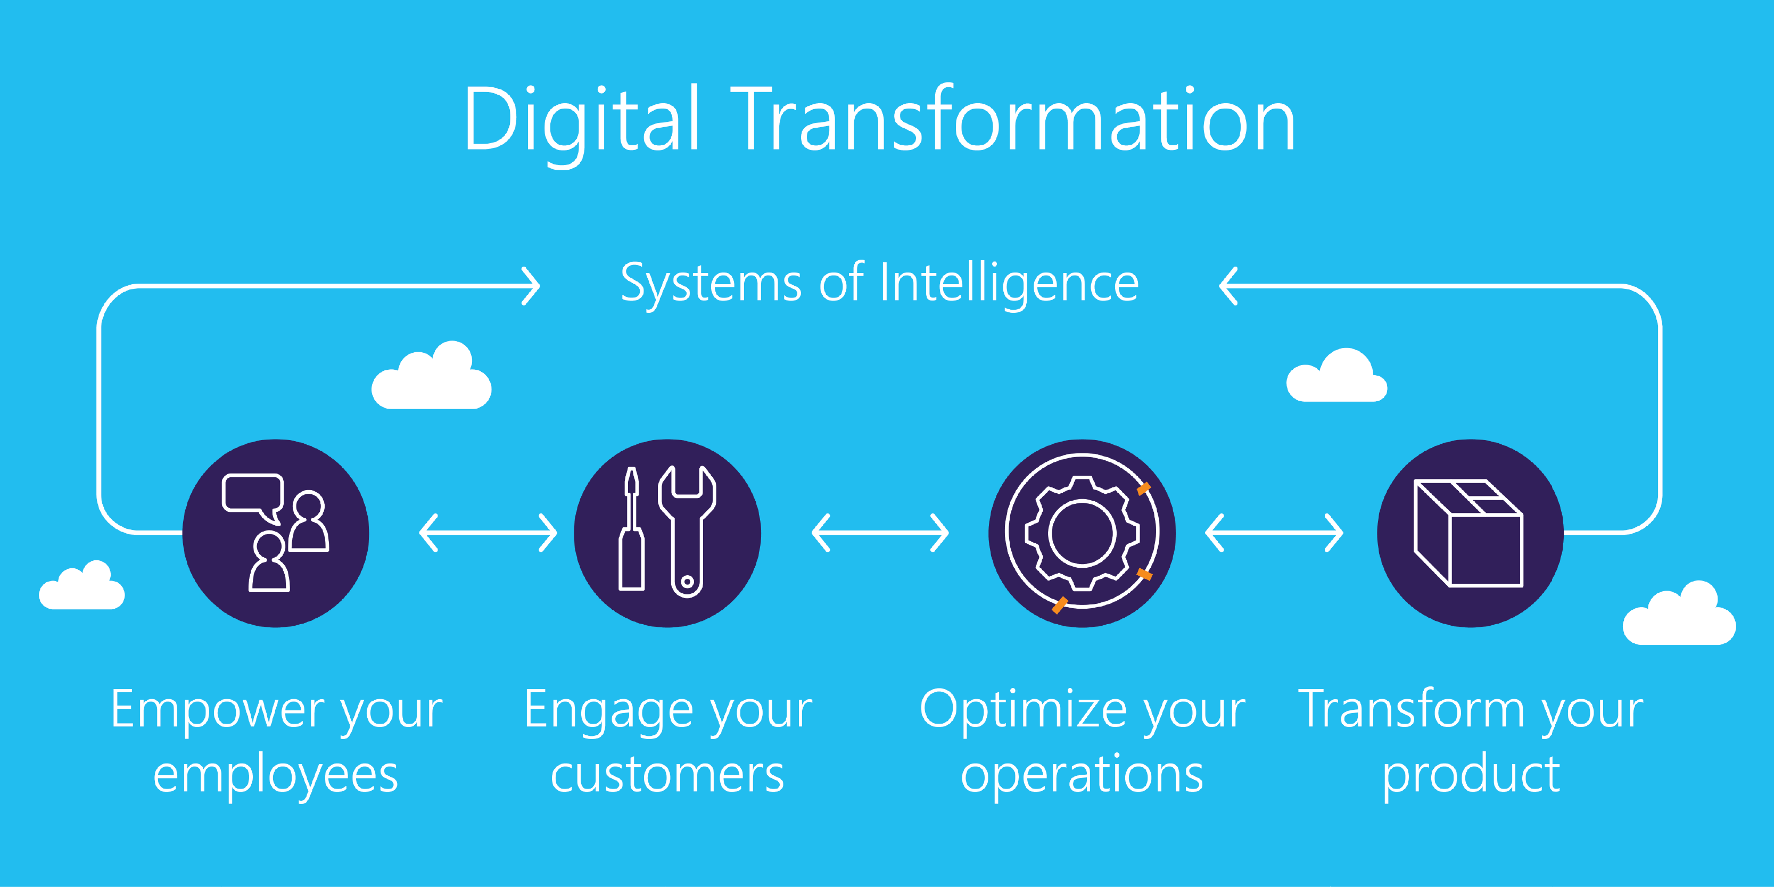

Slide 14
What happen otherwise?

Slide 15



Slide 16
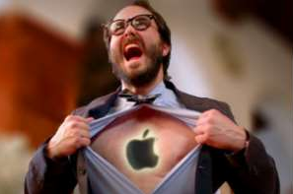
Customers can leave you High competition

Slide 17

What to do & How can we do it?

Slide 18

Stop spending time and effort on things that do not differentiate your Business

Slide 19

Who cares if you have the best email system?

Slide 20

Why to invest in data centers and storage?

Slide 21

Your Employees still call IT to reset their password and unlock accounts?

Slide 22

We are waiting for IT to create for you dashboard, team sites, or give us access!

Slide 23

Security team prevents you from sharing, or working from home?

Slide 24

Manual reviews of millions of security logs

Slide 25

Ask yourself
Does that add value to my customers?

Slide 26


Slide 27

Pay for someone to do it for you

Slide 28

Focus on your customers

Slide 29

Focus on Idea Creation

Slide 30

Let someone else handle things that does not differentiate me
Hire people to do things that affect my customers
New Ideas = Disruption

Slide 31

Give me disruptive Ideas Be Productive

Slide 32

I need tools Work from home
I want to use my home device
Share data with external contractors
Team space & Chat

Slide 33
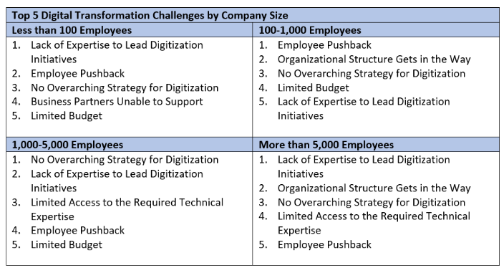

Slide 34

Understand your users
Understanding resistance
15% percent are early adopters
Flexible and roll with the changes.
15% are change resistant.
Won’t change or will make the change only when forced.
70% of users

Slide 35







The Change Curve
shock (“I can’t believe it!”)
denial (“It will never work here!”)
frustration (It’s management’s fault!”)
depression (“I give up. The change is happening whether I like it or not.”)
experimentation (“Well … maybe we could make it work.”)
decision-making (“Let’s move forward.”)
integration (“We’ve made the change. Now let’s get back to business.”).

Slide 36

Greatest value of people is about idea creation, creativity and new innovation.
Knowledge work is about creating content together.

Slide 37

Microsoft wants to help

Slide 38

Focus on your business
We will do the rest
Solution
Microsoft 365

Slide 39

Microsoft 365
A complete, intelligent solution to empower employees to be creative and work together, securely
Formerly called as Secure Productive Enterprise
Office 365
Windows 10 Enterprise
Enterprise Mobility + Security

Slide 40

Host your email, servers, and workloads in our data centers
Empower your employees with the right tools
Still, we will make it secure for you !

Slide 41

New generations.
New expectations.
+50%
of workforce will be millennials by 2020

Slide 42

Flexibility to work from anywhere
+42%
of the global workforce will be mobile by 2022

Slide 43

From routine tasks to creative thinking
72%
of workers believe creativity fuels success

Slide 44

Cyberthreats are at an all-time high
74%
of businesses expect to
be hacked in the next year

Slide 45
Different Way
Smart Way
Yet, Familiar tools

Slide 46
Microsoft 365
Unlocks creativity
Built for teamwork
Integrated for simplicity
Intelligent security

Slide 47

Unlocks creativity
Create compelling content with intelligent apps
Work naturally with ink, voice, and touch
Visualize information in new ways
Connect the experience across devices

Slide 48

Built for teamwork
Email and calendar with Exchange
Connect to people, content, and apps with SharePoint
Voice, video, and chat with Skype and Microsoft Teams
Network across the organization with Yammer
Co-author with Office 365 ProPlus
Office 365 Groups Cross-application group membership

Slide 49
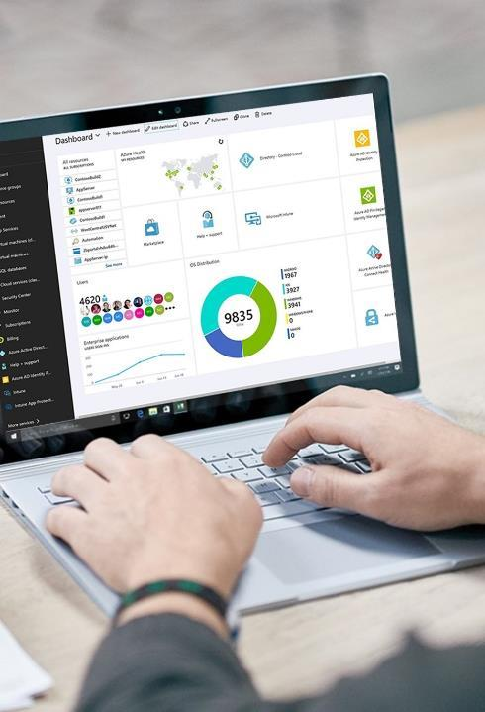
Integrated for simplicity
Deploy, manage, and service your entire estate
Coverage for PC, Mac, iOS, and Android
Manage your entire workforce
Reduce total cost of ownership

Slide 50

Intelligent security
Identity & access management
Information protection
Threat protection
Security management

Slide 51
Microsoft 365
Unlocks creativity
Built for teamwork
Integrated for simplicity
Intelligent security

Slide 52
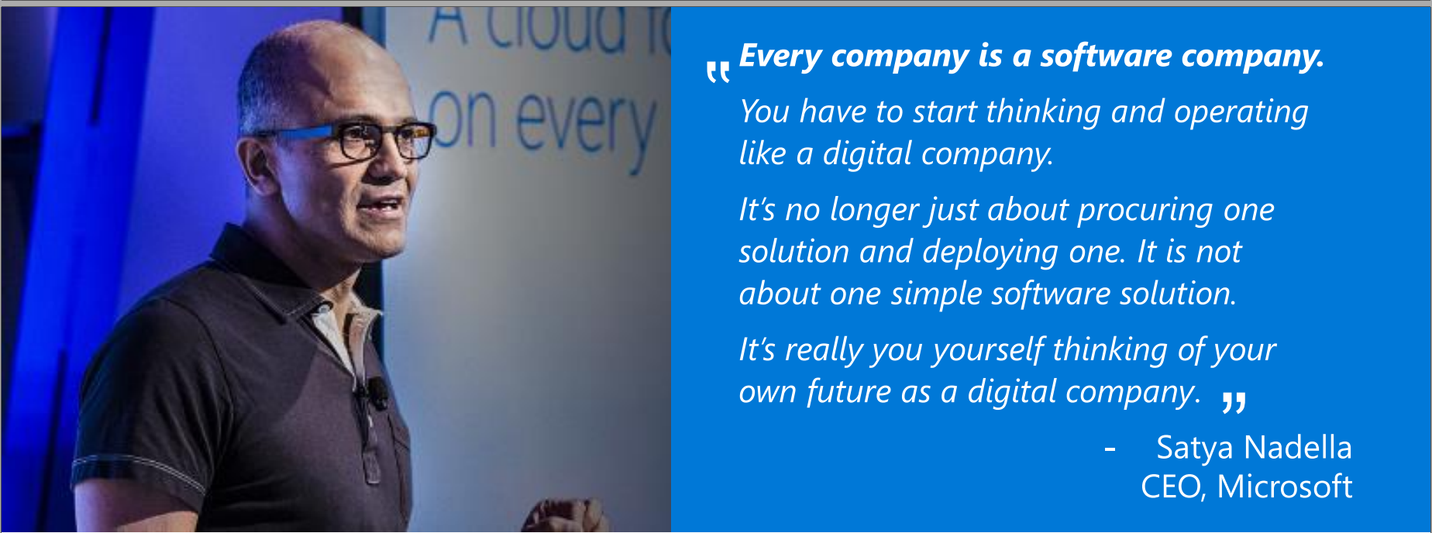

Slide 53

Modern Workplace

Slide 54




Alstom Digital Workplace definiti
Modern Workplace definition :
The Modern Workplace enables new and more effective ways of working.
It allows a more efficient and agile way for users to work.
It exploits consumer-oriented styles and technologies based on user profiling.

Slide 55




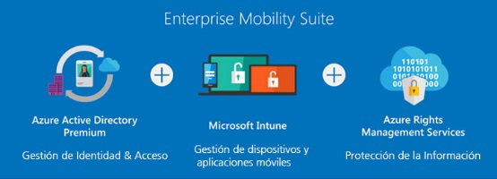






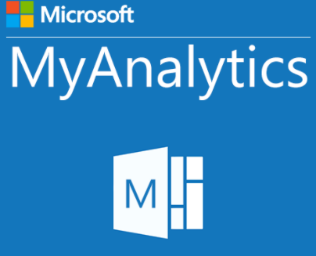







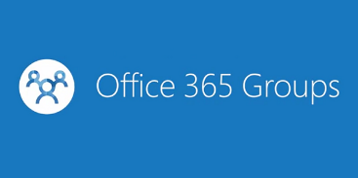





What does a Modern Workplace look like ?

Slide 56

My data should be always available

Slide 57







An illustration of how your data follows you with Office 365 :
Bengaluru Airport
3 hours Layoff at Amsterdam Airport
Frankfurt Airport
My Hotel

Slide 58
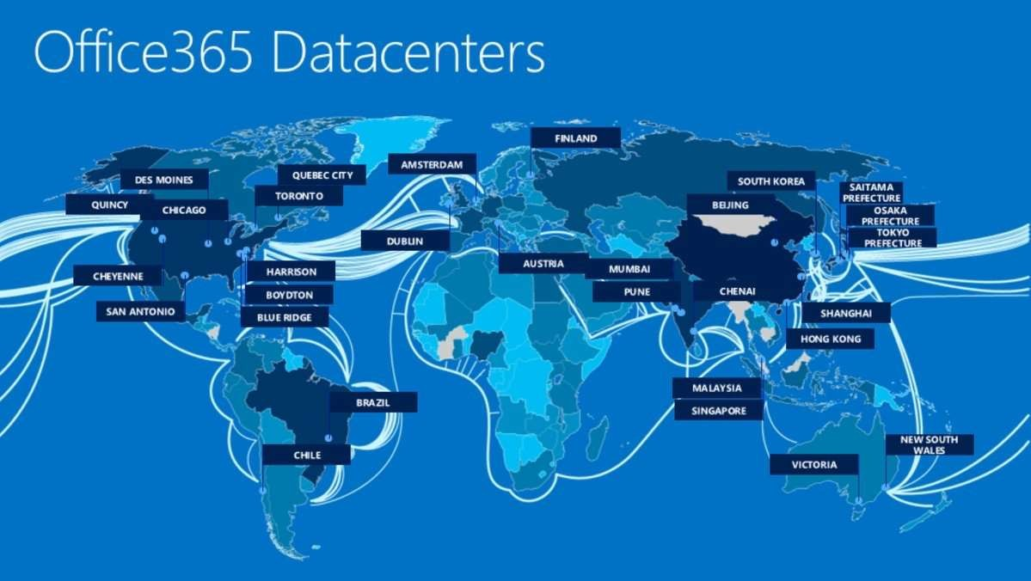
Always Available
Near your users
Always Secured

Slide 59

What about security?

Slide 60
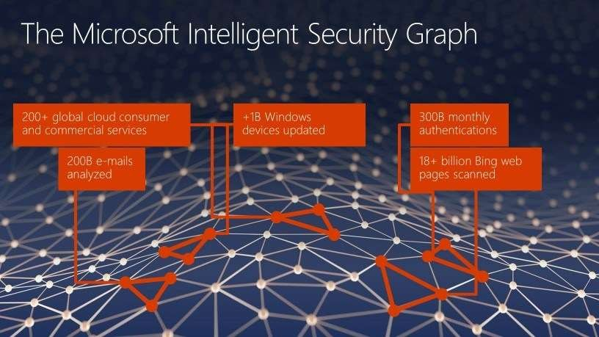

Slide 61
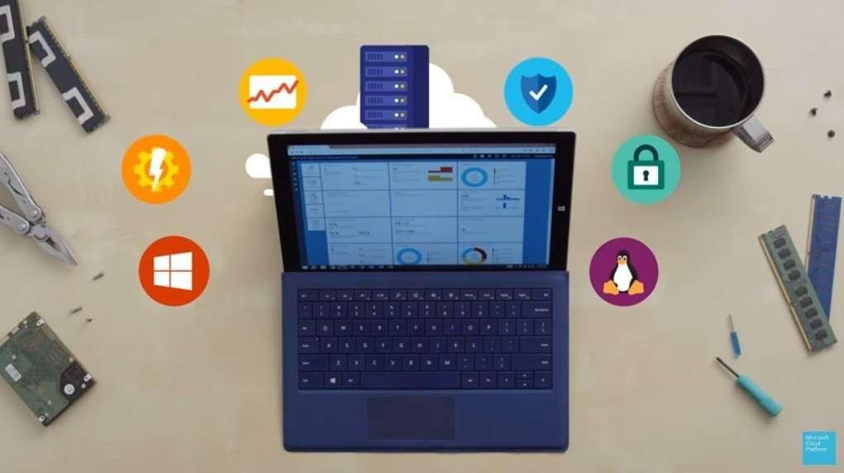
Be Productive, yet secured

Slide 62

Unlock Creativity
And

Slide 63


Conclusion:
Well ! It’s not the end folks it’s just the beginning of the new era and let’s embrace ourselves to cope up with the new Digital Age ….
Jeff Bezos says , The biggest threat to successful companies is “…if you won’t or can’t embrace powerful trends quickly. If you fight them, you’re probably fighting the future. Embrace them and you have a tailwind.”

Slide 64
Thankyou….

Slide 65
Digital Transformation in India :
https://www.microsoft.com/en-in/about/digital-transformation/
https://news.microsoft.com/en-in/features/microsoft-india-cloud-momentum-digital-transformation/
https://news.microsoft.com/en-in/features/inside-indias-digital-transformation-story/

Slide 66

Enjoy the Bootcamp

Slide 67

Call to action
Share your feedback on Bootcamp at https://aka.ms/Microsoft365DevBootcampSurvey2019
Join Office 365 developer program https://dev.office.com/devprogram to leverage all resources for Office 365 development learning
Build applications on Office 365 platform
Attend MVP led local community events to continue learning on Office 365 development

